Slide 1
Scale and Load balance your Architecture

Slide 2
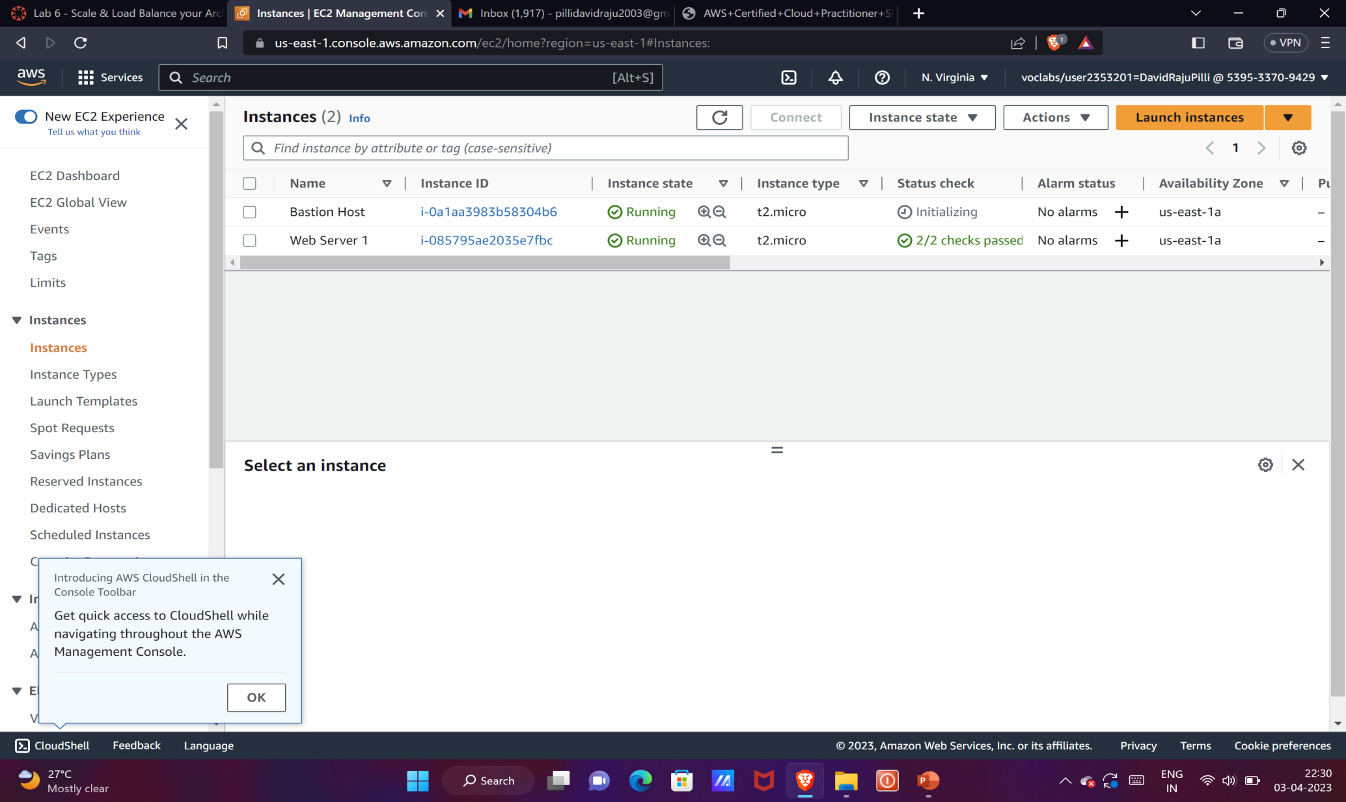
We need to check whether the status checks are done or not.

Slide 3
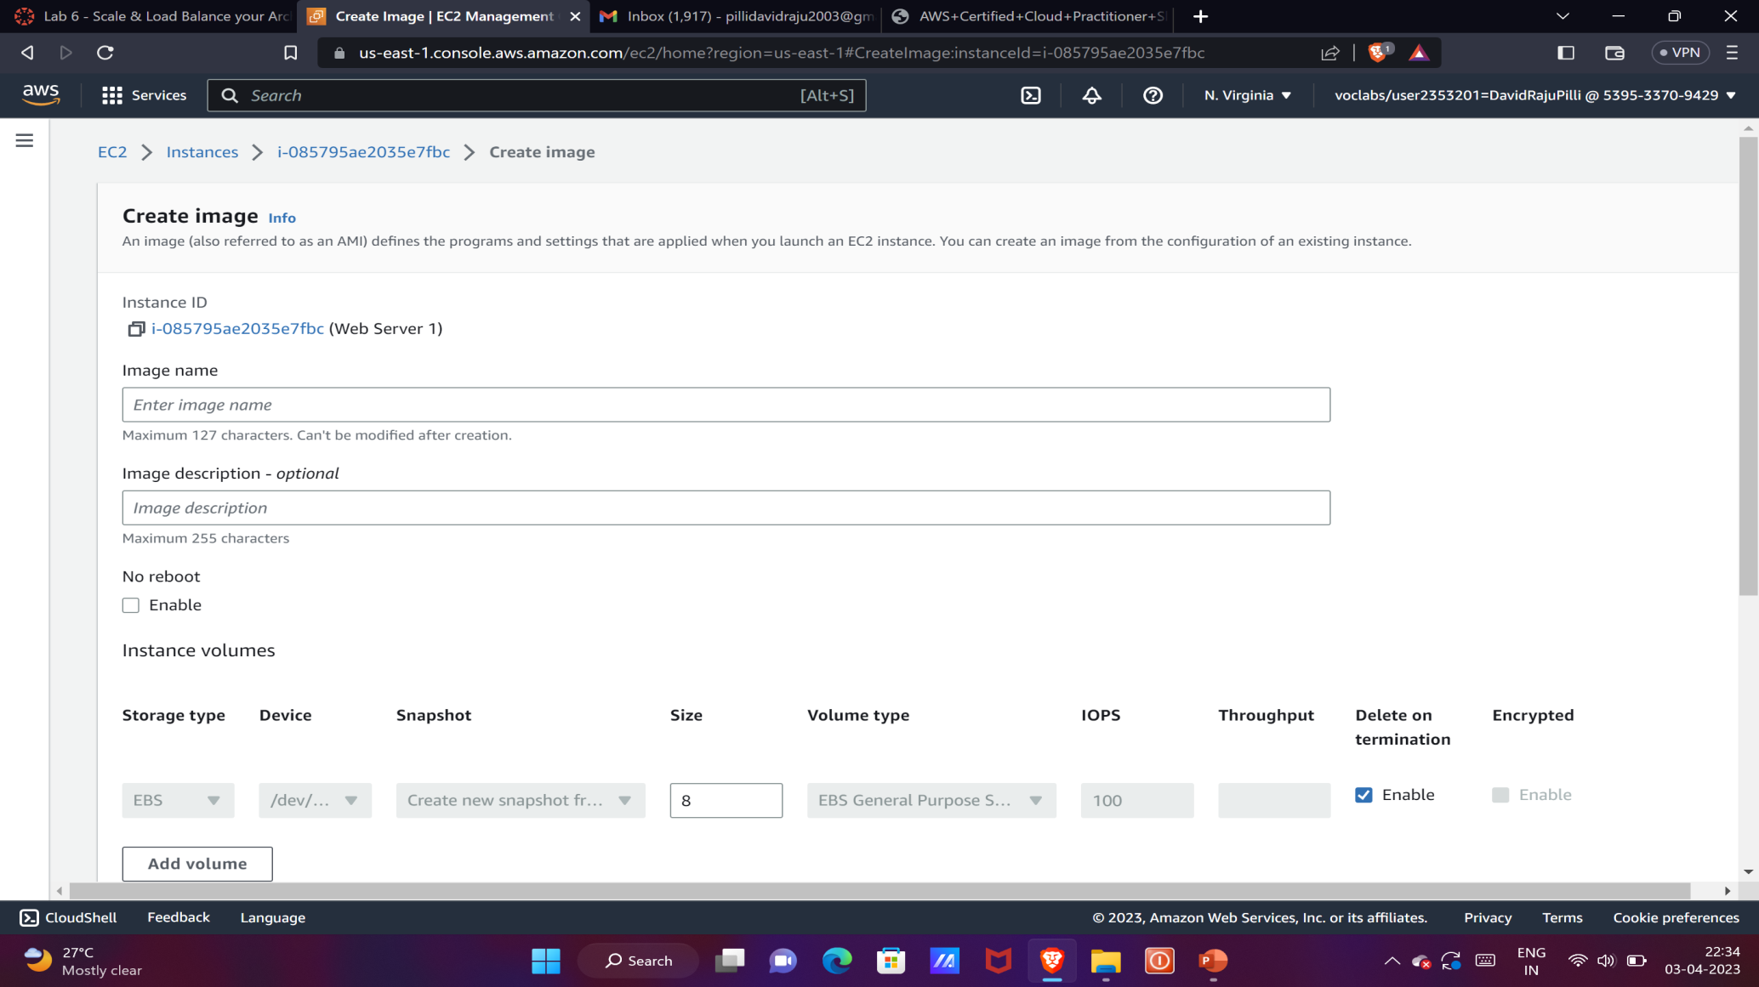
We need to create a image.

Slide 4
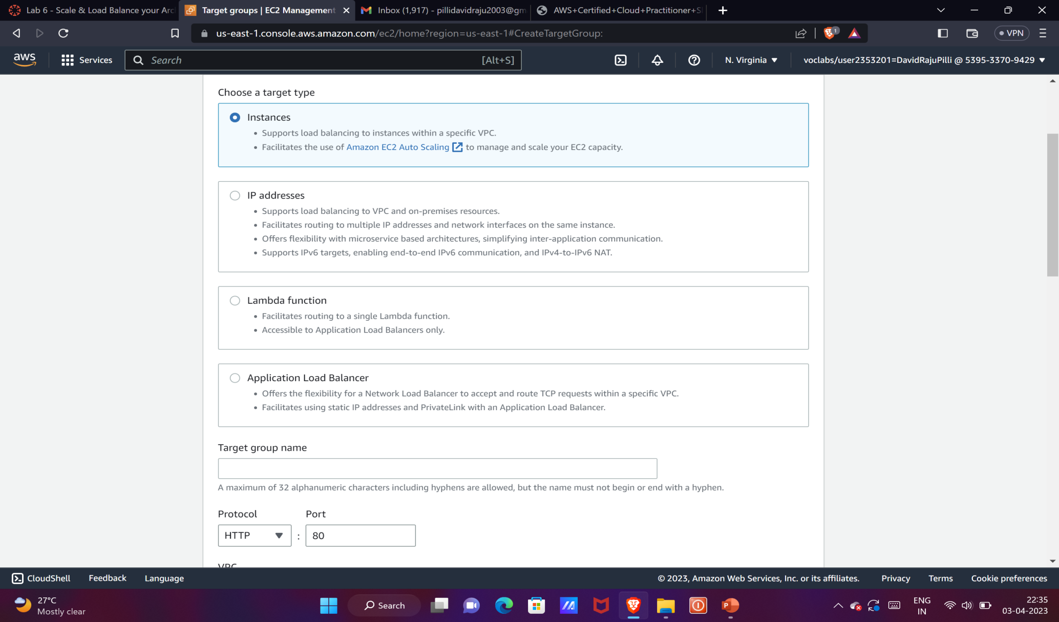
We need to create a target group.

Slide 5
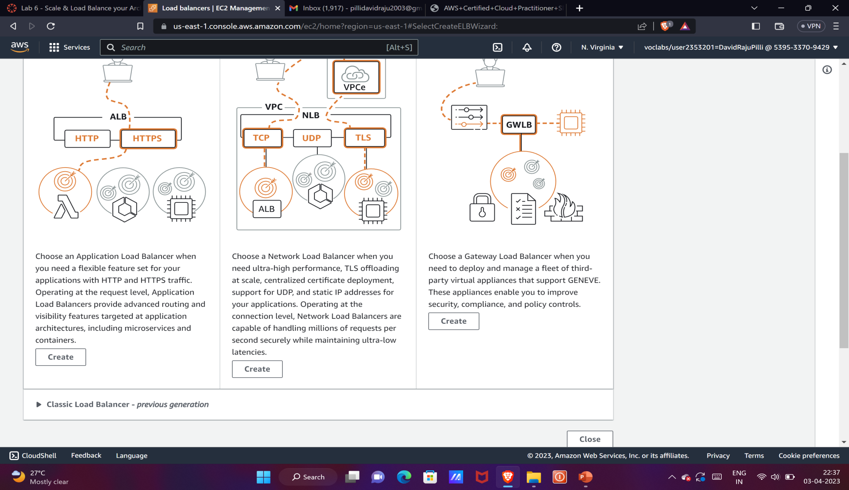
We just need to create a load balancer.
We will need two subnets.

Slide 6
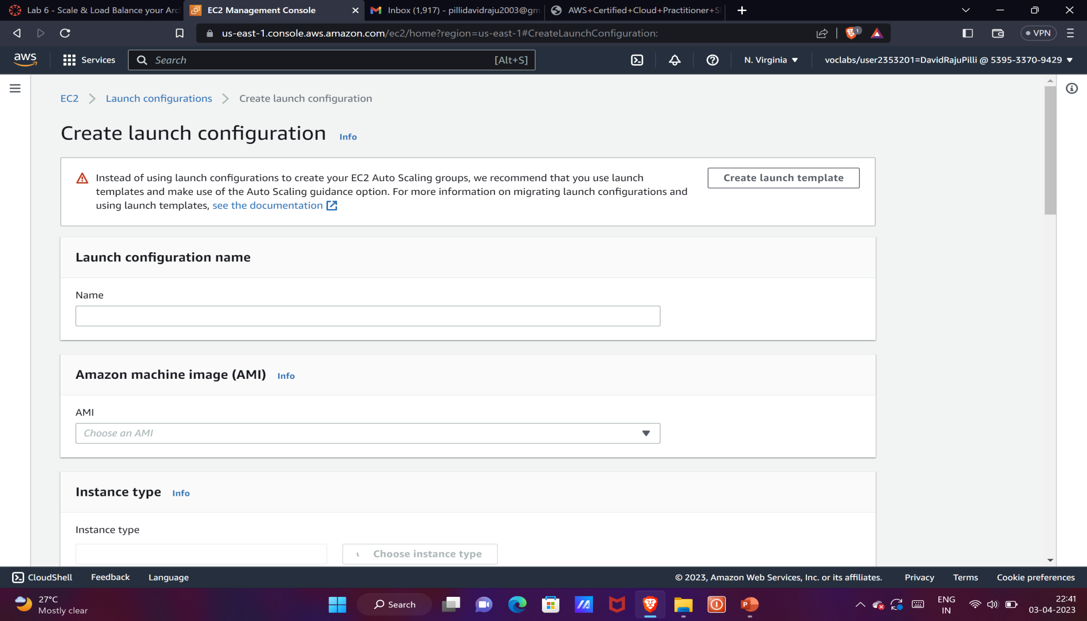
We need to create launch configuration and having t3.micro.
Select enable ec2instance detailedmonitoring within cloudwatch.
Under security group we need select Web Security Group.

Slide 7
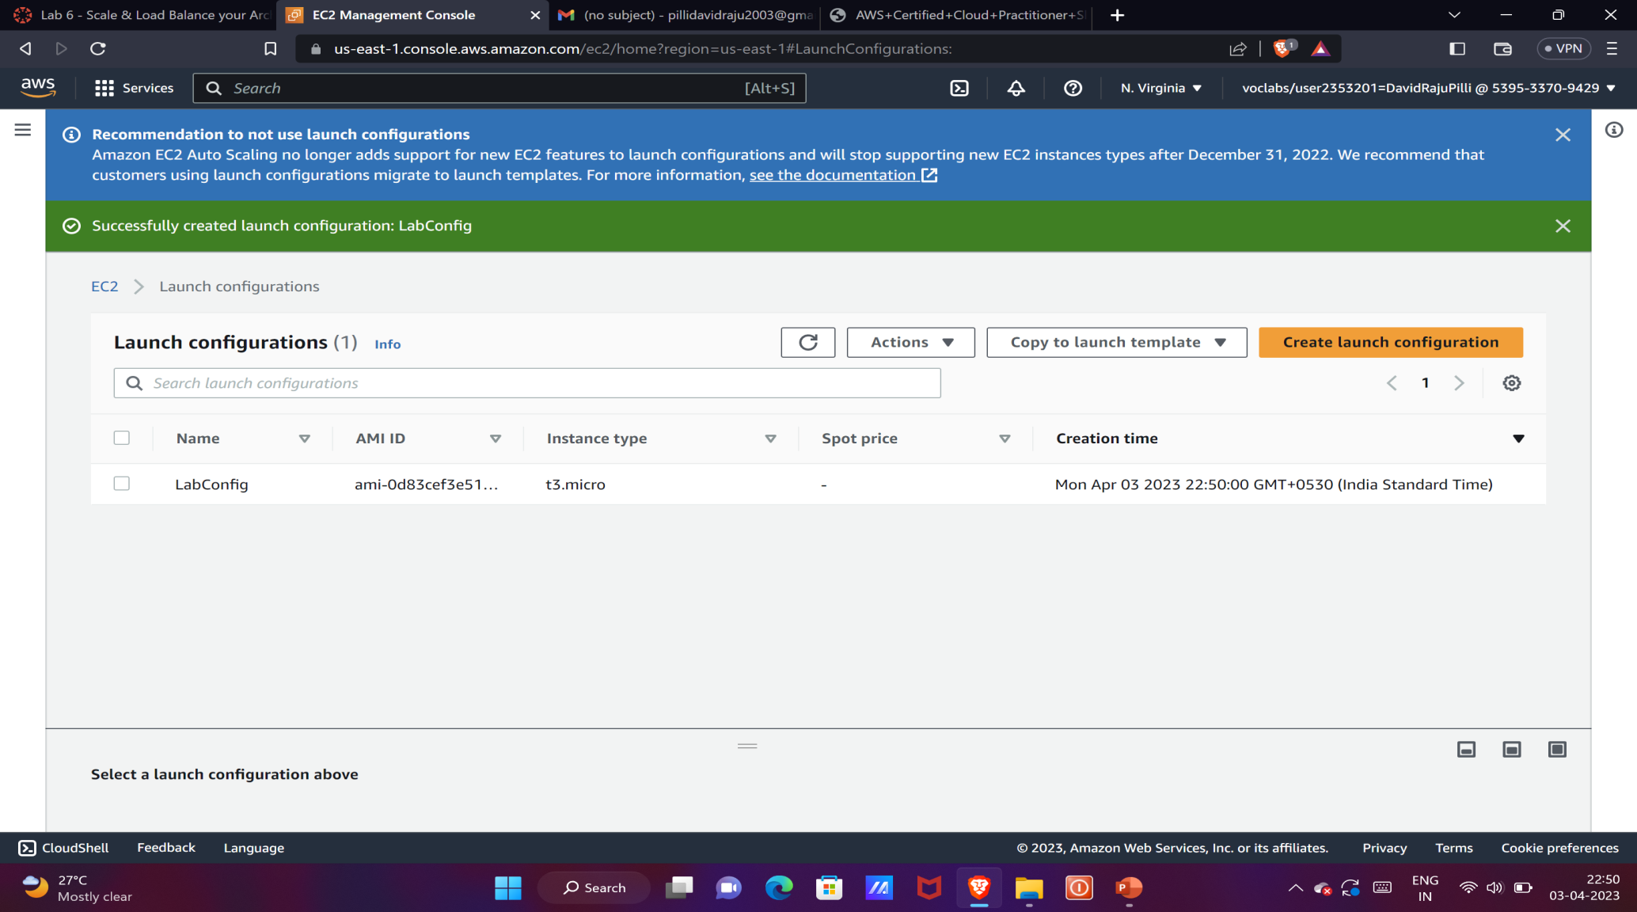
Create auto scaling group, with private subnet 1and2.
We need to attach lab group load balancer.
We need to enable group metrics collection within cloud watch.

Slide 8
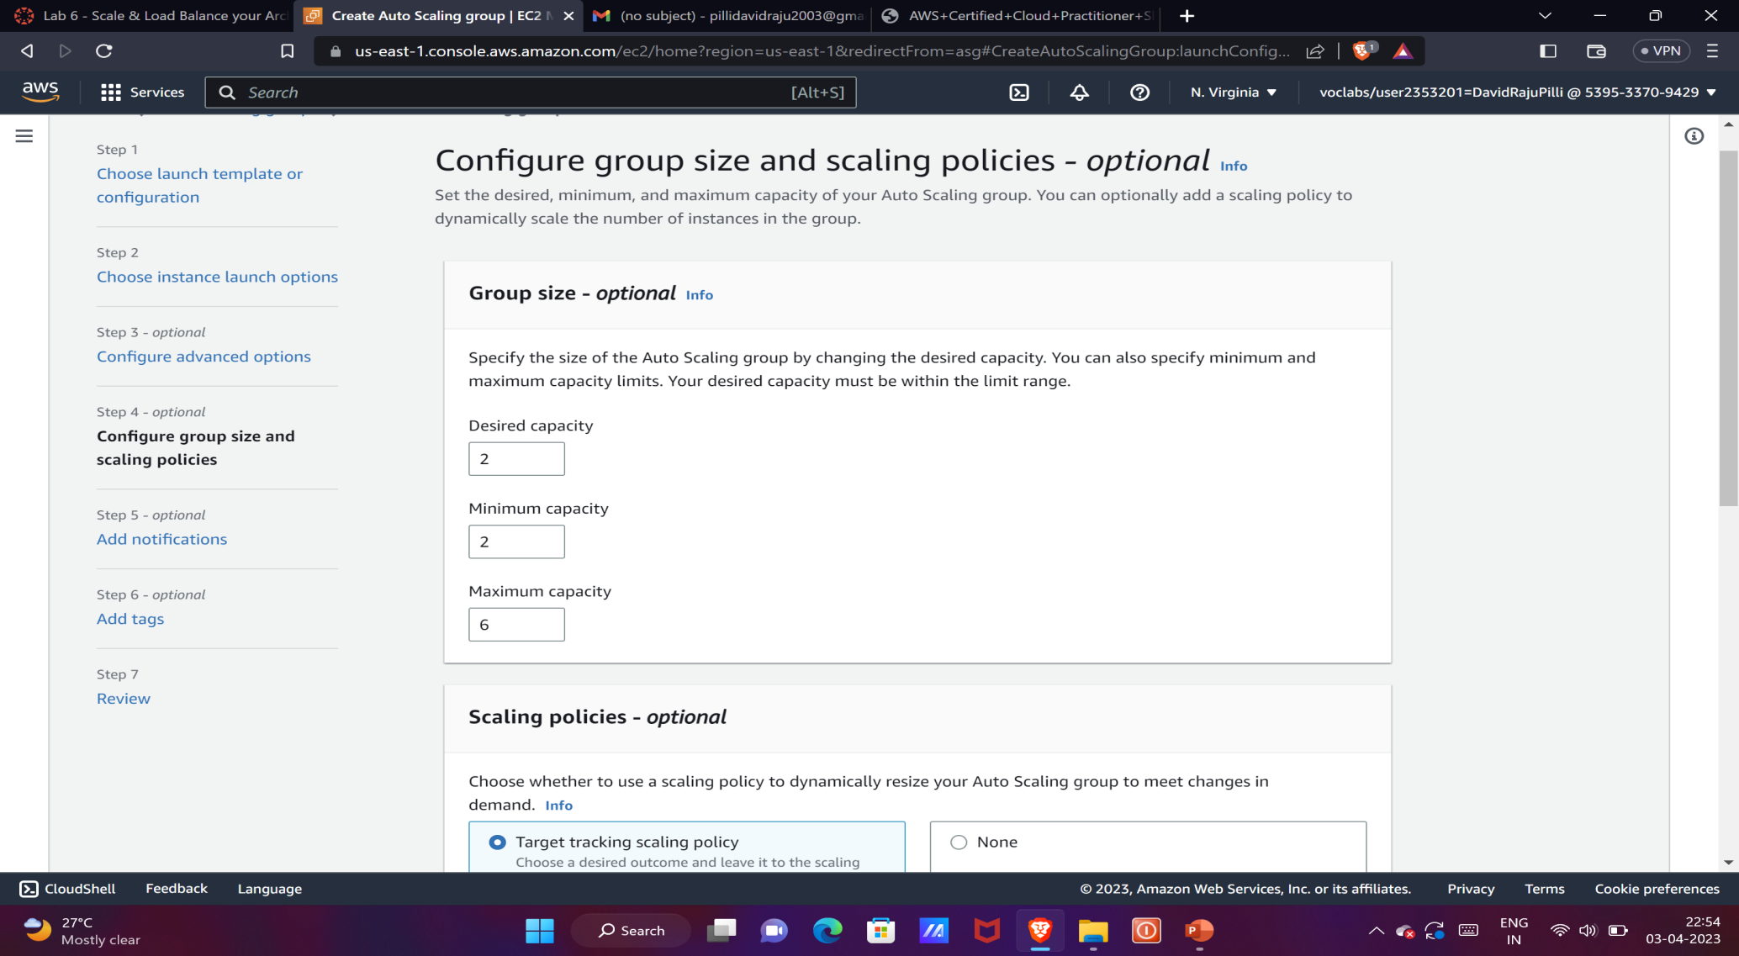
We need to configure group size and scaling policies.
After adding some tags we finally created an auto scaling group.

Slide 9
Verifying whether auto scaling is working or not
Go to instances and you must see two lab instances running.
Their health checks must be pass.
Now click target groups>labgroup>targets.
Two lab instances targets must be listed there.
Wait until both of the health checks status is healthy.
Now go to load balancer and copy the DNS of the load balancer and open it in a new tab.
If you get 100% your scaling group is done.

